Slide 1




PROJECT NAME: BANK ANALYTICS
25\09\2025
TURNING DATA INTO
PROFITS
From Excel Spreadsheets to BI Dashboards – Our Analytical Heist
“The Crew”
| Darshan | Kislay Acharjee | Nabisha Parheen |
| Prerna Ramesh Ramteke | Saish Sandeep Pednekar | Sireesha |
Powered by Data, Backed by Teamwork

Slide 2










VAULT:2
INTORDUCTION
THE PROBLEM
BANKS HAVE DATA, BUT NOT ALWAYS INSIGHTS
1. DAILY TRANSACTION
2. MESSY DATA
3. CONFUSED BANKER
“OUR GOAL: BUILD AN END-TO-END ANALYTICS PIPELINE → INSIGHTS + DASHBOARDS”

Slide 3


VAULT : 3
KPI & INSIGHT
WHAT THE DATA TELLS US
Total Interest
Total Collection
₹88L
₹456L
Interest contributes significantly to overall revenue, showing a healthy lending margin.
Collections exceeded the funded loan amount (₹409L), which shows effective recovery strategies by the bank.
Total Credit Amount
Net Transaction Amount
₹127.6M
₹3.18L
Credit and debit flows are almost equal, indicating balanced financial activity in customer accounts. recovery strategies by the bank.
Even though credits and debits are nearly the same, a positive net transaction shows overall growth momentum in the system.

Slide 4

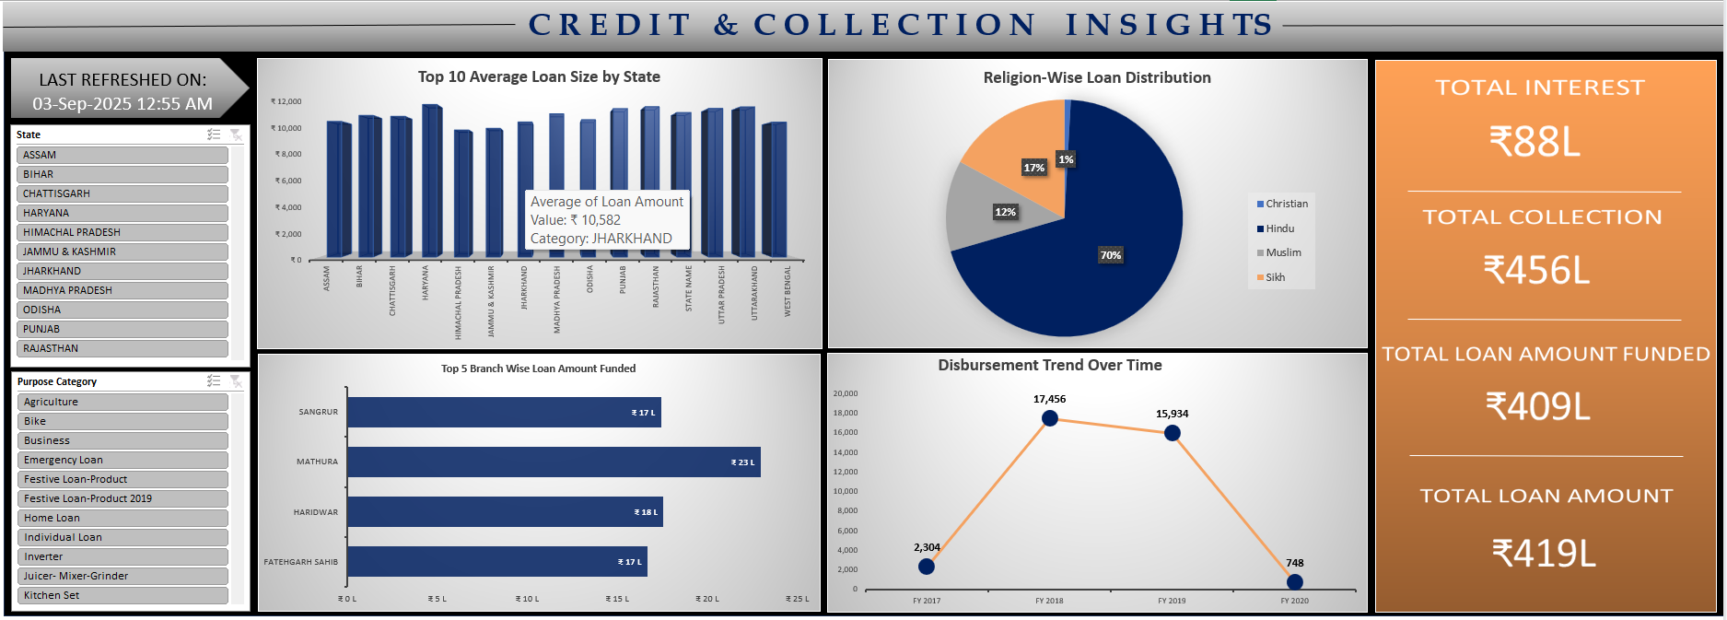
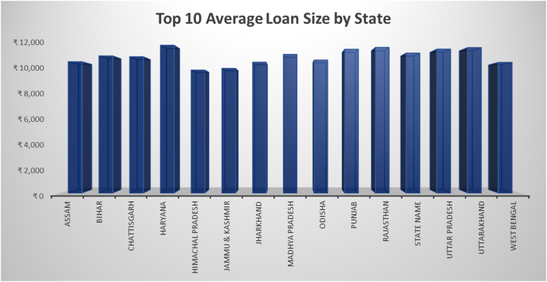
VAULT :4
EXCEL DASHBOARD MISSION-1
BANK DATA ANALYTICS
Dataset Used -

Slide 5
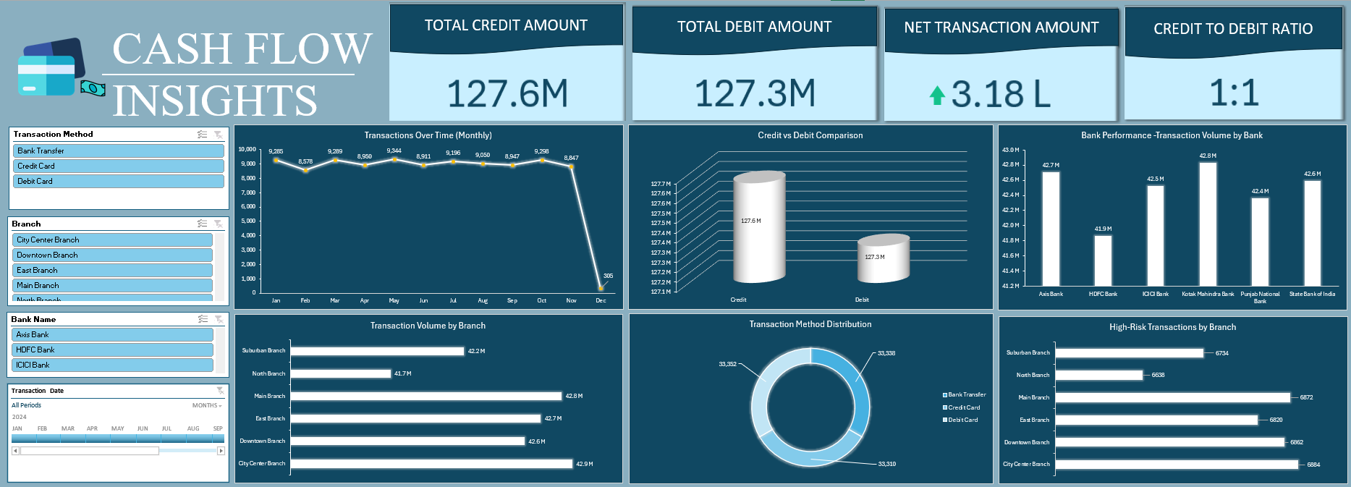
VAULT :5
EXCEL DASHBOARD MISSION-2
Dataset Used -
CREDIT & DEBIT BANKING DATA

Slide 6

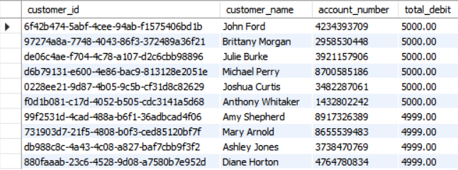
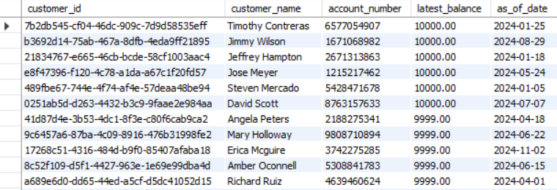
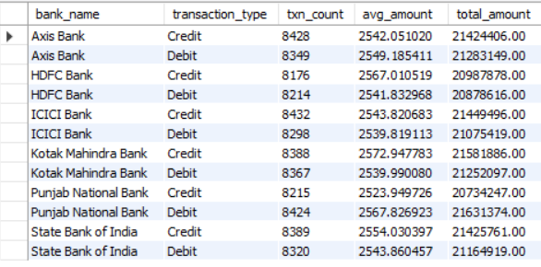
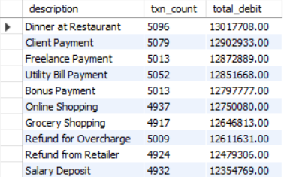
VAULT : 6
SQL QUERIES
BANK DATA ANALYTICS
THE QUERY BLUEPRINT
Top 10 customers by Total Debit in a year
Customers with Highest Ending Balance
Average transaction amount by Bank and Type
Top 10 Spending Categories (Descriptions) for Debit

Slide 7

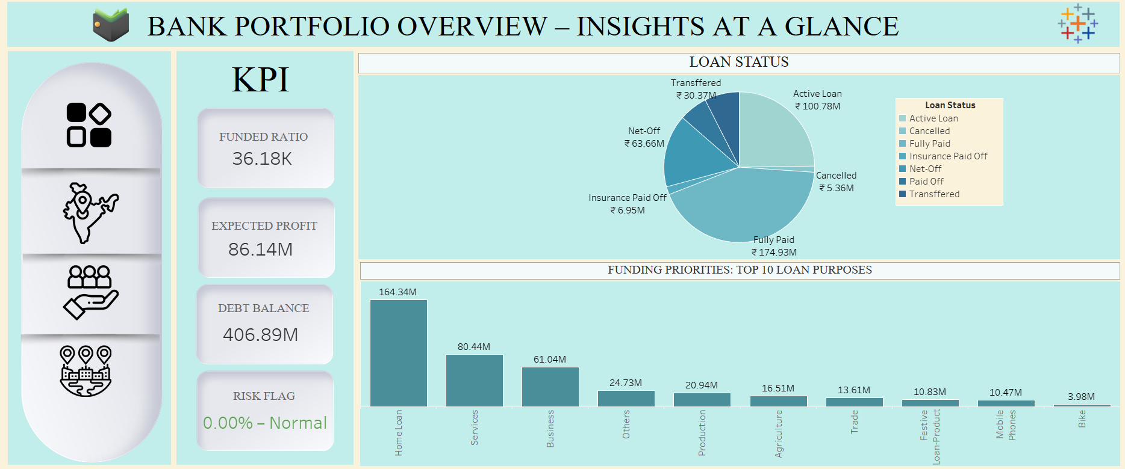
VAULT: 7
TABLEAU DASHBOARD MISSION
CREDIT & DEBIT BANKING DATA
TABLEAU TALES
OVERVIEW

Slide 8

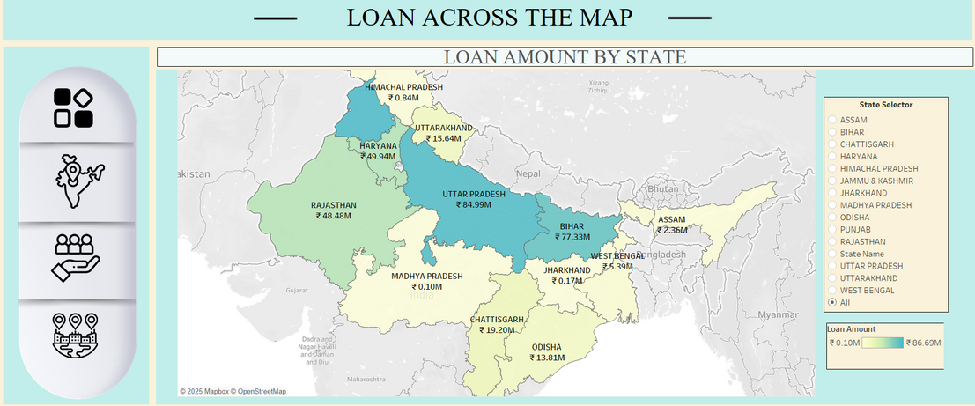


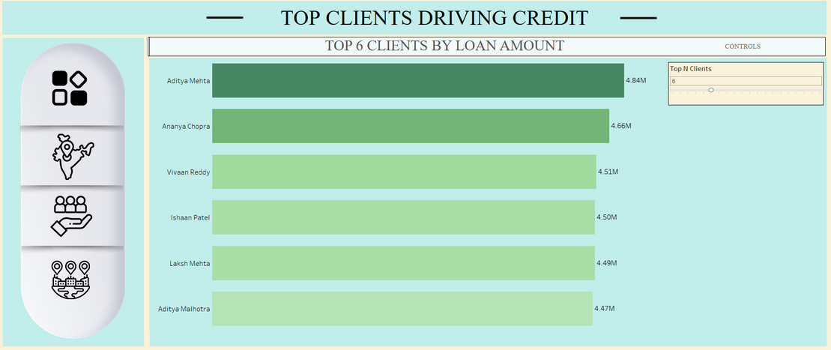
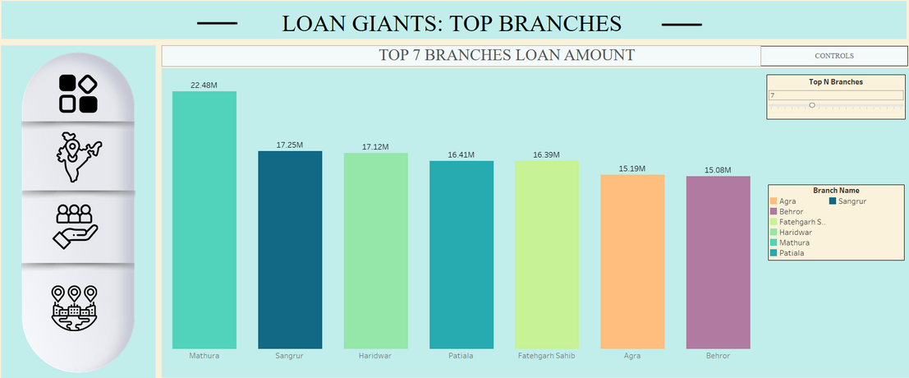
VAULT: 8
TABLEAU DASHBOARD MISSION
CREDIT & DEBIT BANKING DATA
BY STATE
BY CLIENT
BY BRANCH

Slide 9

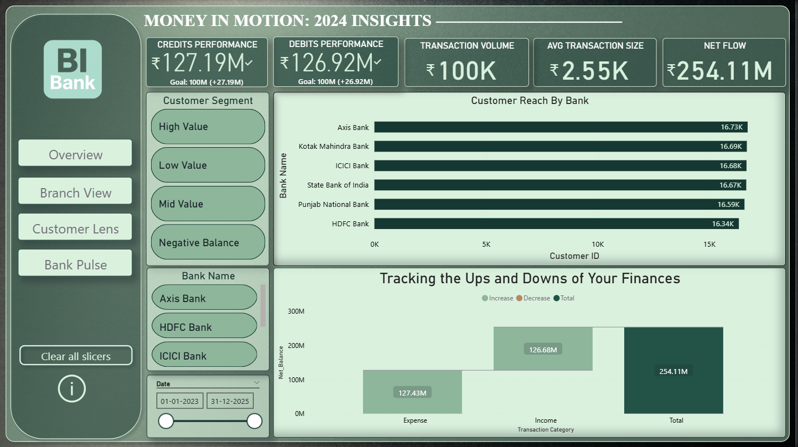
VAULT : 9
POWER BI DASHBOARD MISSION
CREDIT & DEBIT BANKING DATA
POWERING INSIGHTS WITH BI
OVERVIEW

Slide 10
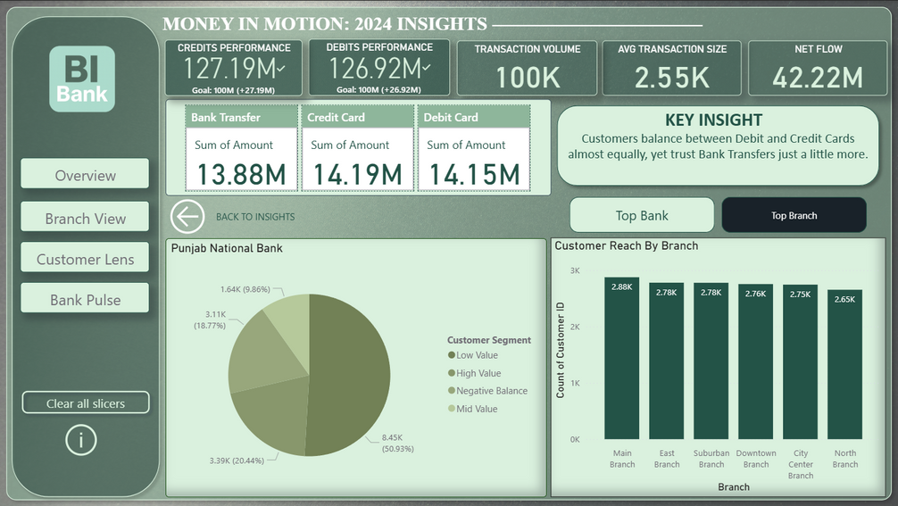
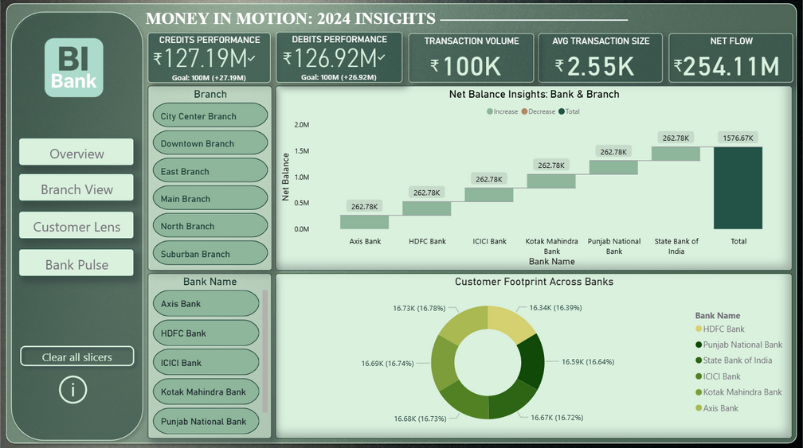
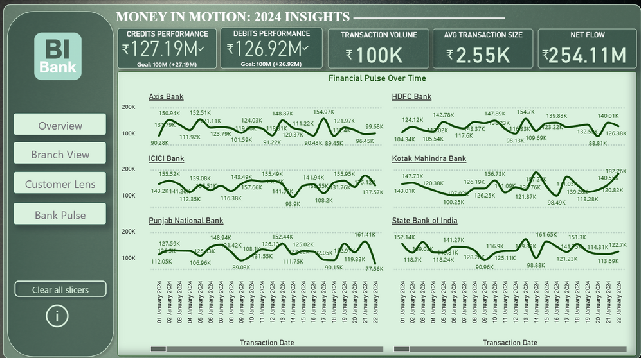
VAULT : 10
POWER BI DASHBOARD MISSION
CREDIT & DEBIT BANKING DATA
BRANCH VIEW
CUSTOMER LENS
BANK PULSE

Slide 11











VAULT : 11
BEHIND THE SCENES: OUR HURDLES
Excel crashes
Pivot optimization saved us.
SQL syntax errors Debugging
+
practice.
1M rows import wizard failed Server-side CMD import.
Tableau navigation broke-
Fixed with teamwork + research.
Power BI slicer chaos
Solved with proper modeling.

Slide 12





VAULT: 12
SUMMARY
THE BIG PICTURE
Built interactive dashboards across tools
Automated insights with SQL queries
Interactive storytelling
Consolidated executive insights

Slide 13

VAULT: 13
MISSION COMPLETE
100%
THANK YOU FOR BEING PART OF IT
Every vault we opened was full of data, and every key was teamwork

